Slide 1


"College Alumni Portal"
Presented by
Miss. Vadke Saie Suraj (Exam seat-295029)
Miss. Vanve Gauri Dhananjay (Exam seat- 295026)
Miss. Saykar Punam Mahadev (Exam seat-295030)
Guided By
Prof Nagare. P. H

Slide 2
Contents
Introduction
Abstract
Existing System/Drawbacks
Proposed System/Advantages
Software Requirements
Hardware Requirements
Diagrams
Future Scope
Conclusion
Reference

Slide 3
Introduction
We are formulating the best alumni web portal which will facilitate effective communication platform through online chatting and profile viewing within three stakeholders of the institute viz- Admin, College students , Alumni Students.
This portal will be providing direct contact of the alumni with the students as well as the staff members. This keeps the students updated with the current updates and demands of the industrial market.

Slide 4
Abstract
Alumni portals is providing common platform for every institute. Owing to the need to have all the Alumni (already passed out students) must be connected to the Institute, resulted in sharing their experiences, views, ideas, guidance, motivations and strategies.
The objective Of Alumni portal application is to allow old and new students of the college to communicate with each other.

Slide 5
Existing System
The existing system is built with number less excel sheets that are created by each user.
These sheets may be collated by an alumni organization and shared with all the alumni but this activity may not be frequent. The system is difficult to maintain on a regular process and it also have a privacy issues.

Slide 6
Drawbacks
It cannot be used frequently.
Data can be losses.
This system cannot maintain regularly.
There is security and privacy problem may occur.
This is a large process to maintain all user details.

Slide 7
Proposed System
The application allow to student to register and then search the Database on different criteria. also it has benefit of having a centralize database and up to date information
A user can easily obtain information about other registered user

Slide 8
Advantages
To keep a roster of all Alumni of college and their pertinent data.
Maintaining the updated and current information of all Alumni.
To encourage, foster and promote close relations among the alumni themselves.
To guide and assist Alumni who have recently completed their courses of study

Slide 9
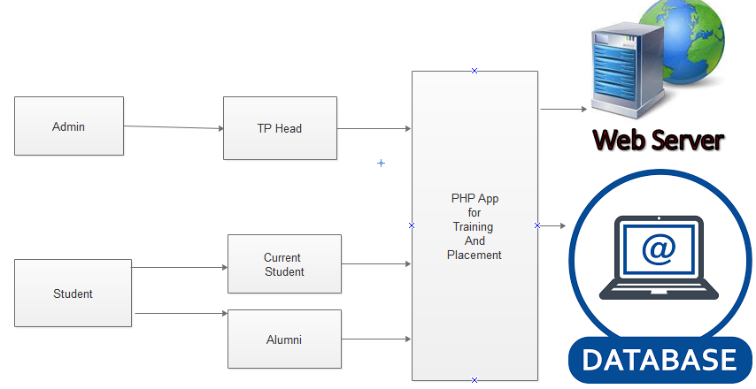
Proposed System Diagram

Slide 10
Software Requirements
Operating System : Windows XP/2003/7/10, or Linux/Solaris
User Interface : HTML, CSS, Wamp Server
Client-side Scripting : Java Script
Programming Language : PHP
Database : MYSQL

Slide 11
Minimum Hardware Requirements
Processor : Pentium IV or above
Hard Disk : 40GB
RAM : 256MB

Slide 12
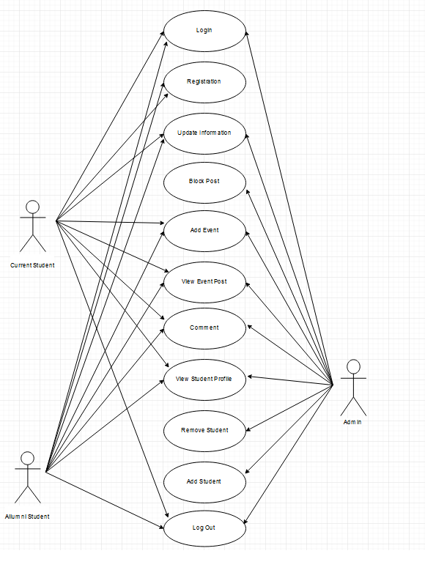
Use Case Diagram
Fig : Use Case Diagram

Slide 13
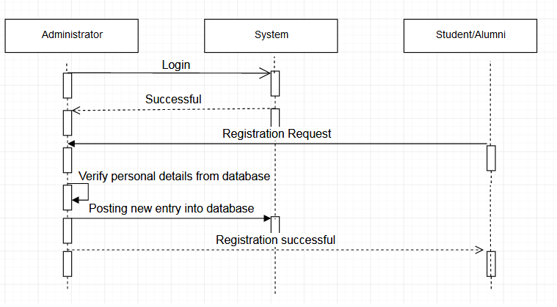
Sequence Diagram
Fig : Sequence Diagram

Slide 14
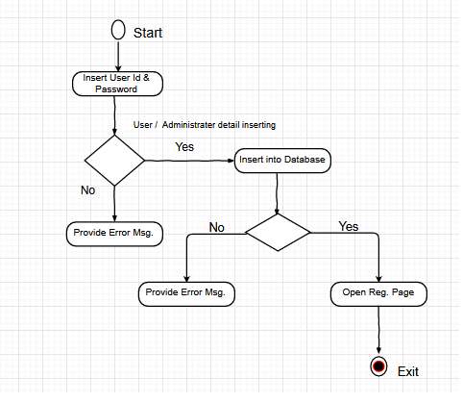
Data Flow Diagram
Fig : Data Flow Diagram Level 0

Slide 15
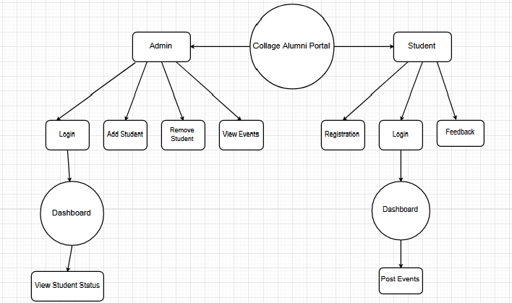
Fig : Data Flow Diagram Level 1

Slide 16
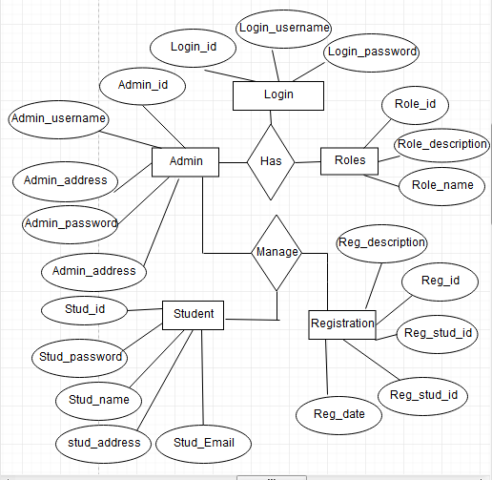
Entity Relationship Diagram
Fig : Entity Relationship Diagram

Slide 17
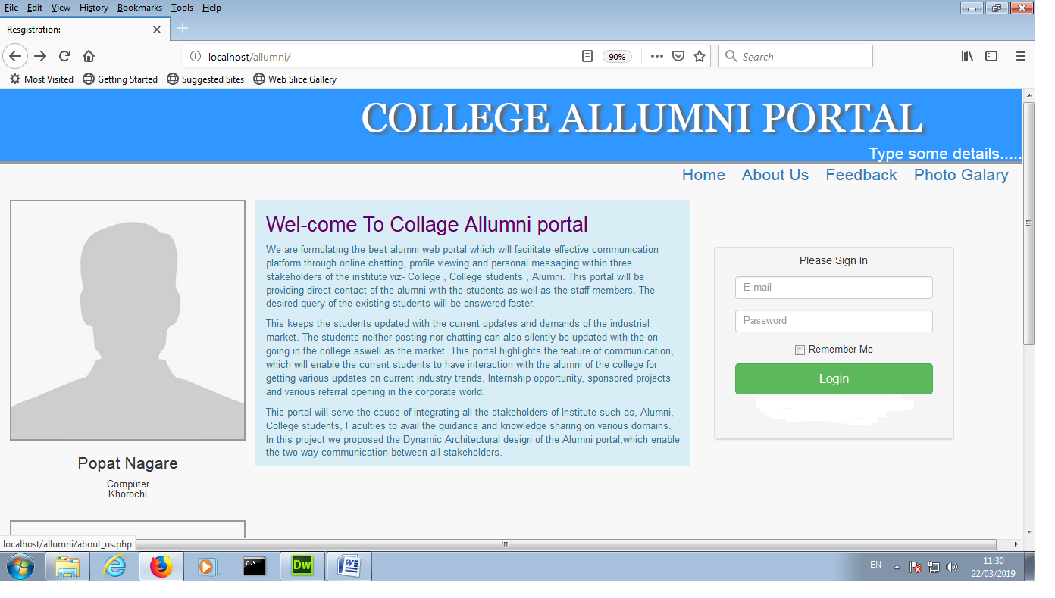

Slide 18
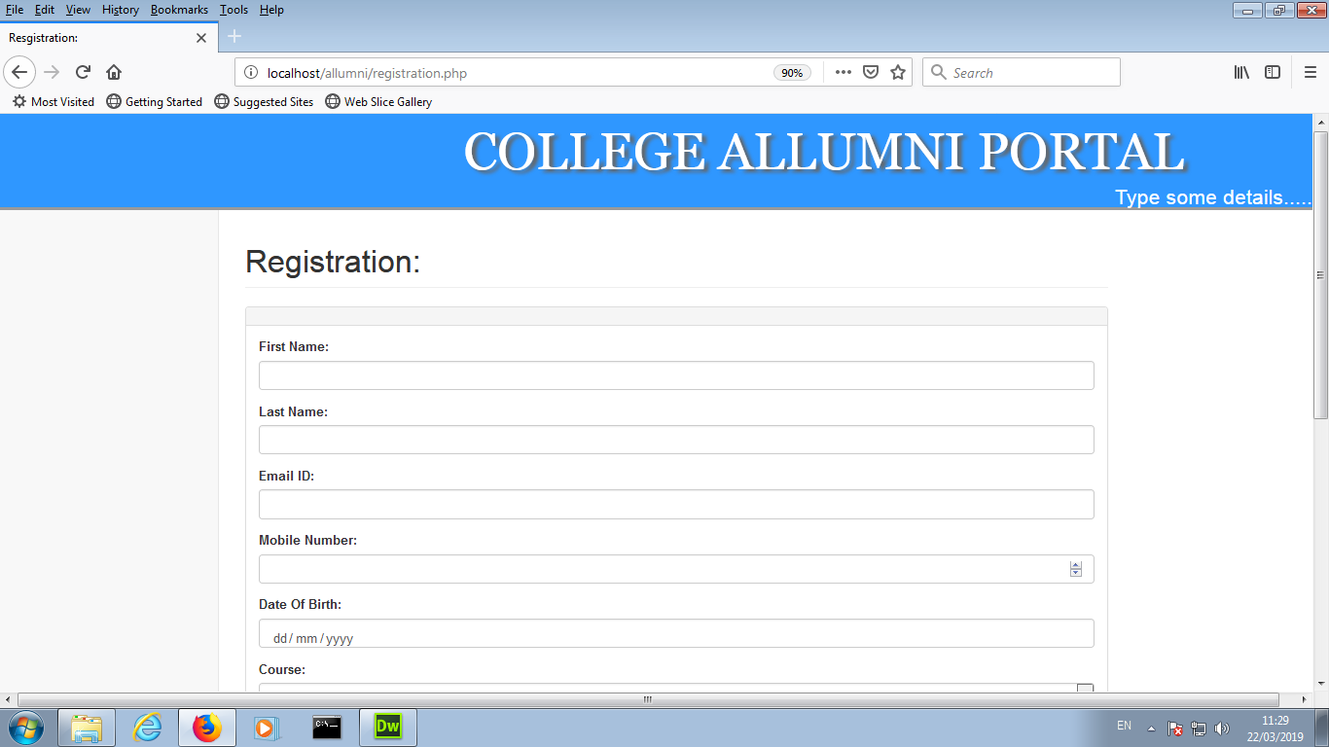

Slide 19
Scope
To keep a roster of all Alumni of college and their pertinent data.
Maintaining the updated and current information of all Alumni.
To encourage, foster and promote close relations among the alumni themselves.
To promote a sustained sense of belonging to the Alma Mater among the Alumni by being in regular contact with them.

Slide 20
Conclusion
The Alumni Information Database is mainly used to share the views between the users of the application which is very useful to upgrade the knowledge of everyone. The application is also serve as a useful site to know what is going on in our in our college and can also know about the various opportunities of the outer world. The application can be further expanded by following the future Enhancements mentioned above.

Slide 21
Reference
HTML & CSS: The Complete Reference, Fifth Edition (Complete Reference Series) 5th Edition by Thomas A. Powell (Author)
PHP Tutorial:- Programming PHP by Rasmus Lerdorf, Kevin Tatroe, Peter MacIntyre
HTML Tutorial :- Head First HTML with CSS & HTML (Head First Series) by Elisabeth Robson
Bootstrap:- Bootstrap by Jake Spurlock
The Joy of PHP Programming: A Beginner's Guide – by Alan Forbes. ...

Slide 22
Thank You....

